Slide 1

HDMI CEC Introduction
Mstarsemi Leo.Lin
2007-5-10

Slide 2
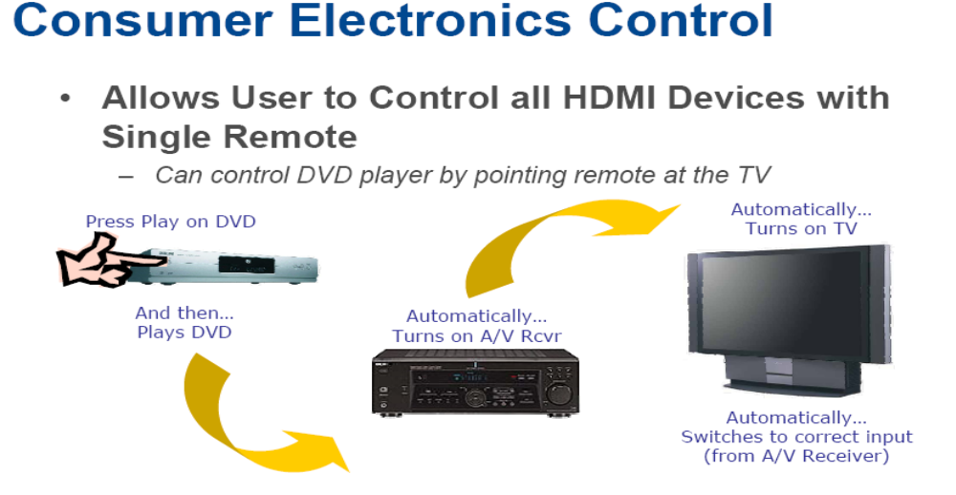
What is HDMI CEC Use For?
CEC是提供给用户的一种用于各种视听设备之间的高级控制功能协议，
条件是视听设备必须有HDMI信号接口。

Slide 3

Automatic Format Intelligence

Slide 4
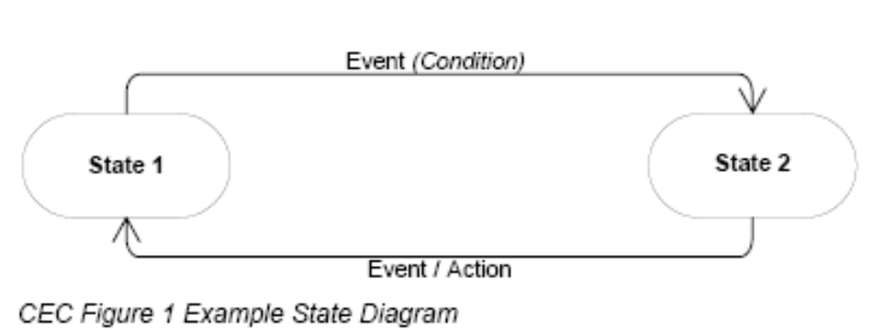
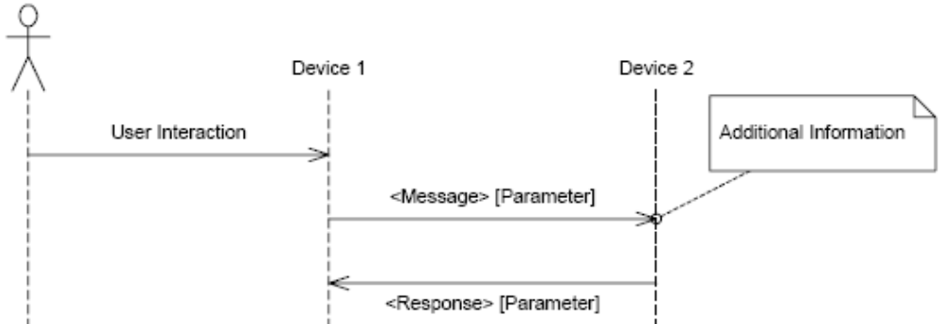
CEC 用法和协定
1.State Diagrams:描述了设备状态与事件或者动作之间的行为关系，参看下图:
Message Flow Diagrams:描述了两个交互设备之间传递消息的时序，参看下图

Slide 5
CEC Feature概述
CEC定义了部分增强HDMI设备之间功能性和交互性的推荐控制特征(Features),包括以下两大部分:
1) End-User Features,列举如下:
One Touch Play - Allows a device to be played and become the active source with a single button press.
System Standby - Enables the user to switch all devices to standby with one button press.
One Touch Record - Offers a What You See Is What You Record (WYSIWYR) facility, meaning that whatever is shown on the TV screen is recorded on a selected recording device.
Deck Control - Enables a device to control (e.g. play, fast forward etc.) and interrogate a playback device (a deck).
Tuner Control - Allows a device to control the tuner of another device.
Device Menu Control - Enables a device to control the menu of another device by passing through user interface commands.
Remote Control Pass Through - Enables remote control commands to be passed through to other devices within the system.

Slide 6
CEC Feature概述
2) Supporting Features,列举如下:
Device OSD Name Transfer - Enables devices to upload their preferred OSD name to the TV. The TV can then use this name in any menus associated with that device.
Device Power Status – Allows the current power status of a device to be discovered.
OSD Display - Enables a device to use the on-screen display of the TV to display text strings.
Routing Control - Allows the control of CEC Switches for streaming of a new source device.
System Information - Queries the system to determine device addresses and language.
Vendor Specific Commands - Allows a set of vendor-defined commands to be used between devices of that vendor.

Slide 7
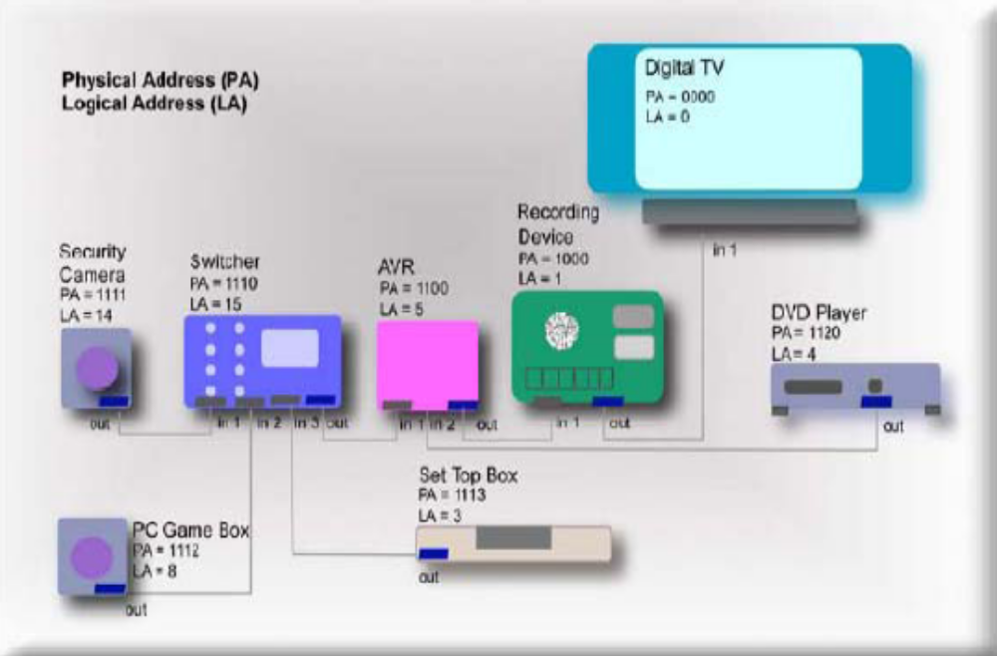
CEC电性能
CEC电性能设计规范保证了即使在最坏的情况下，也可以支持最多达10个device之间的交互操作，而实际上这种最坏情况很难发生，所以一般情况下可以有更多的(>10)设备可以交互操作。

Slide 8
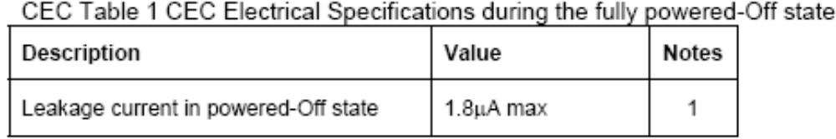
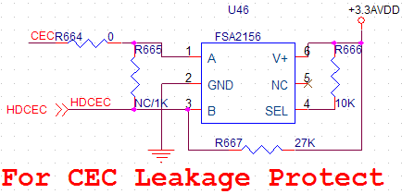
CEC电性能
如果一个设备遵循CEC协议即执行CEC功能，则必须满足下述电性能条件:
1)当设备处于关机状态(或者拔除电源)的情况下，参看下表
PS:意味着这种情况下device内部的上拉电路必须与CEC line断开。下图的电路中FAS2156模块就是为此而加的。

Slide 9
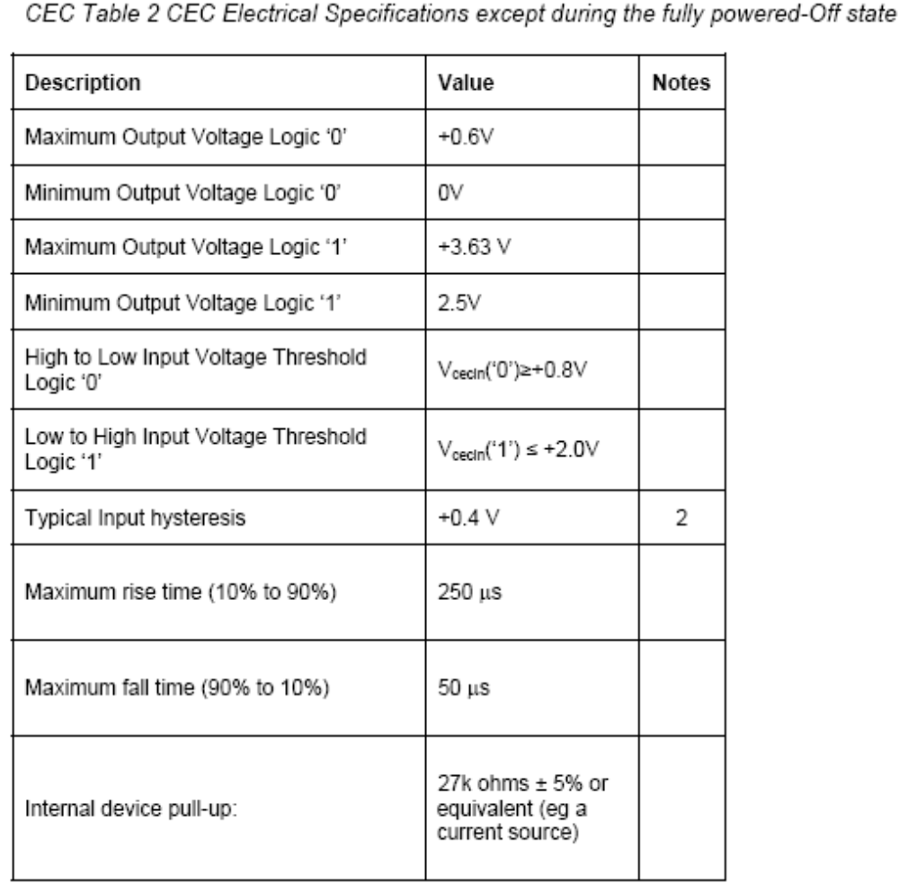
CEC电性能
1)当设备处于其他状态
下，须满足右表条件:
PS.在这些状态中，Device 必须随时侦测该设备自己的CEC line上的消息，包括任何解除其standby状态的消息。而且要求device在full-loading的情况下也要满足表中的电性能参数。
“Internal device pull-up”决定了内部电路中的CEC line的上拉电阻(总和)必须为27k ohms ± 5%.

Slide 10
CEC Signaling and Bit Timings
All transactions on the CEC line consist of an initiator and one or more followers. The initiator is responsible for sending the message structure and the data. The follower is the recipient of any data and is responsible for setting any acknowledgement bits.
A message is conveyed over the control signal line in a single frame; a frame is a self-contained unit consisting of a start bit followed by a number of data bits.
（具体的技术细节请参考HDMI Spec 1.3 CEC spec）

Slide 11
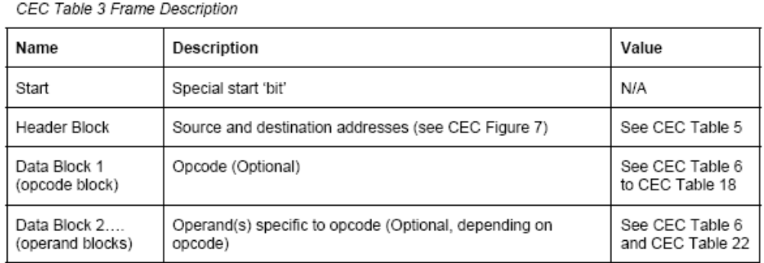
CEC Frame Description
如上页所述CEC信息的单位是以帧(Frame)来传送的，所以这部分对帧的结构（参看下表），并对Header/Data Block description，EOM (End of Message)，ACK (Acknowledge)进行详细说明.
（具体的技术细节请参考HDMI Spec 1.3 CEC spec）

Slide 12
CEC Other Communication Mechanisms
由于CEC使用于设备间的交互，所以需要保证消息传递的可靠性以及传递方法，设备地址的定义等进行详细规范，所以有很多明确的规定和要求…（具体的技术细节请参考HDMI Spec 1.3 CEC spec）

Slide 13
CEC应用实例
CEC简化数字家庭的操作，一个遥控器可以控制所有支持HDMI的数字产品 现时在很多不同品牌上都可看到CEC的身影，只是每一制造商给它的名字有异。 如松下电器(Panasonic)的VIERA Link，三星电子(Samsung)的Anynet+，LG电子的SIMPLINK，索尼(Sony)的BRAVIA SYNC，索普(Sharp)的Fami Link等。功能上大致都是借着CEC信号让用者可控制HDMI接口上所连接的装置。如单键播放(One Touch Play)，系统待机(System Standby)。 即是如果用者将影碟放进蓝光播放器时，电视会由于CEC信号的通知而自动开机，然后视频通道亦会自动切换到播放器连接的通道上。而当用者关掉电视时，CEC信号亦会通知HDMI相连接的装置一同进入待机。由于这样，所以就可以完全变成单一遥控器控制所有HDMI连接的装置。

Slide 14
The End
Thank you!

